Slide 1




Slide 2

TEAM NAME : Artificial Un-Intelligence
Member 1 : A n u r a g A n a n d
Member 2:Tanisha Priya
Member 3: Tarun Sitaraman
Member 4: Sachin R
TRACK: Blockchain and Web3

Slide 3
PROBLEM STATEMENT
Whistleblowers play a critical role in exposing corruption, misconduct, or injustice — but current reporting systems are flawed:
Centralized systems can be hacked or controlled by authorities
Evidence can be tampered with or deleted
Lack of trust discourages people from speaking up
Whistleblowers risk their identity being exposed
There is no secure, anonymous, and tamper-proof platform where people can safely submit reports — especially in places where freedom of speech is at risk.

Slide 4
PROPOSED SOLUTION
WhisprChain is a decentralized whistleblowing platform that empowers individuals to submit sensitive reports anonymously and securely. Leveraging Zero-Knowledge Proofs, IPFS, and blockchain, it ensures identity protection, tamper-proof evidence storage, and public access to truth—without fear, censorship, or compromise.
Anonymity: No login or personal details required
Tamper-proof Evidence: Files stored on IPFS (decentralized and immutable)
Immutable Metadata: All report details are logged on the Polygon blockchain
ZK-Style Identity Simulation: Keeps whistleblowers completely anonymous
Searchable Reports: Easy to search by tags, keywords, event names, or date
Privacy Control: Submitter can mark a report as Public or Private
Authority Access : Trusted parties can view private reports if authorized

Slide 5
METHODOLOGY
1. Upload Evidence Secretly
- What Happens: A user uploads evidence files (screenshots, PDFs, etc.) to a decentralized storage system.
- Technologies Used: IPFS, Filecoin, File Hashing
2. Stay Anonymous
-What Happens: User identity is hidden — no login, no wallet trace, no tracking.
-Technologies Used: ZK Identity/Semaphore, Tornado Cash, MetaMask
3. Time-Stamped, Tamper-Proof Log
- What Happens: A blockchain smart contract logs the file hash and timestamp permanently.
- Technologies Used: Polygon Blockchain, Solidity, Web3.js
4. Track Reports Publicly
- What Happens: Authorities, journalists, and NGOs can view submitted reports via a public dashboard.
- Technologies Used: React.js, Tailwind CSS, IPFS Gateway

Slide 6
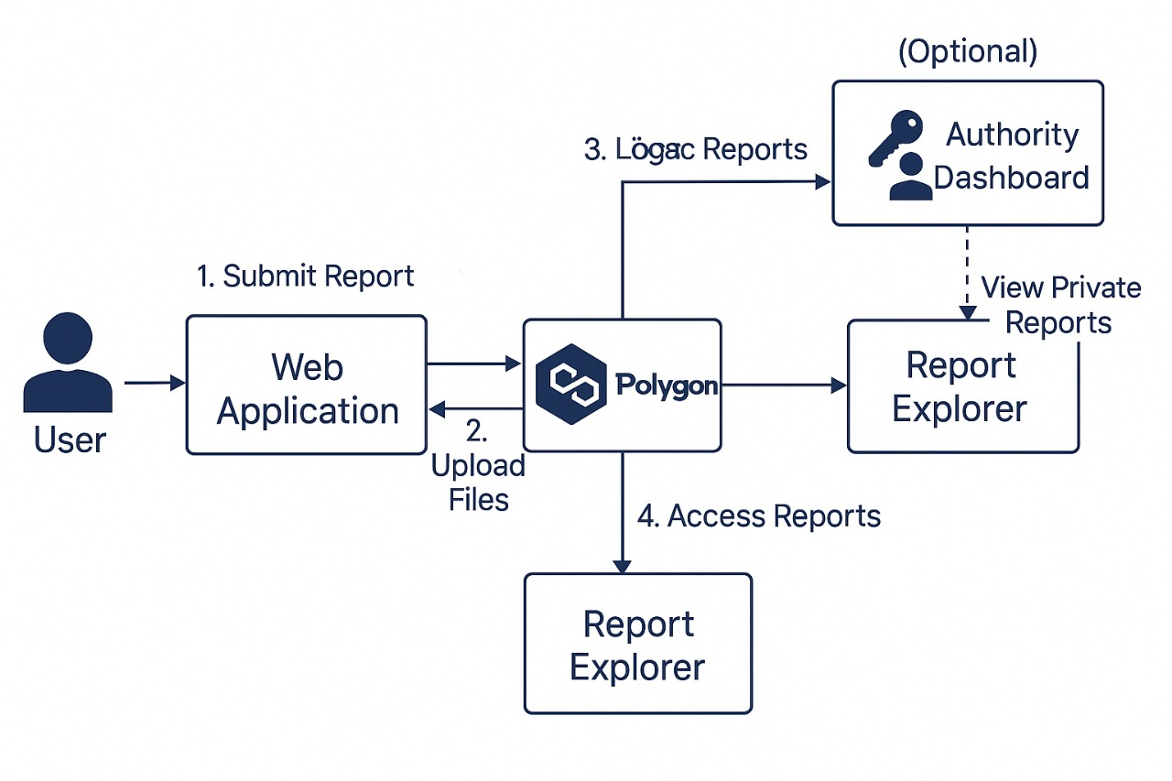
ARCHITECTURE DIAGRAM

Slide 7
SCALABILITY AND FUTURE SCOPE
Future Scope
WhisprChain isn’t just a project—it’s a movement toward a safer, more transparent society. By empowering individuals to speak out without fear, it can transform how India and the world handle injustice, corruption, and abuse of power.
Scalability and Growth Potential
National Platform: Can evolve into a trusted national system where citizens, journalists, and government watchdogs rely on blockchain-verified, anonymous reporting.
Societal Benefits
Exposing corruption in public offices, schools, hospitals, police, and politics—while protecting those who come forward Giving voice to the voiceless: From workplace harassment victims to students facing injustice or rural citizens dealing with exploitation

Slide 8
CONCLUSION
Our decentralized whistleblower platform empowers individuals to report corruption, abuse, and injustice anonymously, securely, and immutably. By combining blockchain, IPFS, and ZK-style privacy, we eliminate the risks of censorship, data tampering, and identity exposure.
This solution is:
Trustworthy – No need to rely on third parties
Tamper proof – All data is verifiable and permanent
Accessible – Public reports can be explored by anyone for Journalism
Future ready – Built with scalable and modern Web3 tools.
A world where speaking the truth is risky, we provide a safe, decentralized voice.

Slide 9
ATTACHMENTS
GITHUB LINK : https://github.com/Frostyanand/WhisprChain

